Slide 1

Autonomous Car
Presented by:
Ali Saber
Youssry Atef

Slide 2
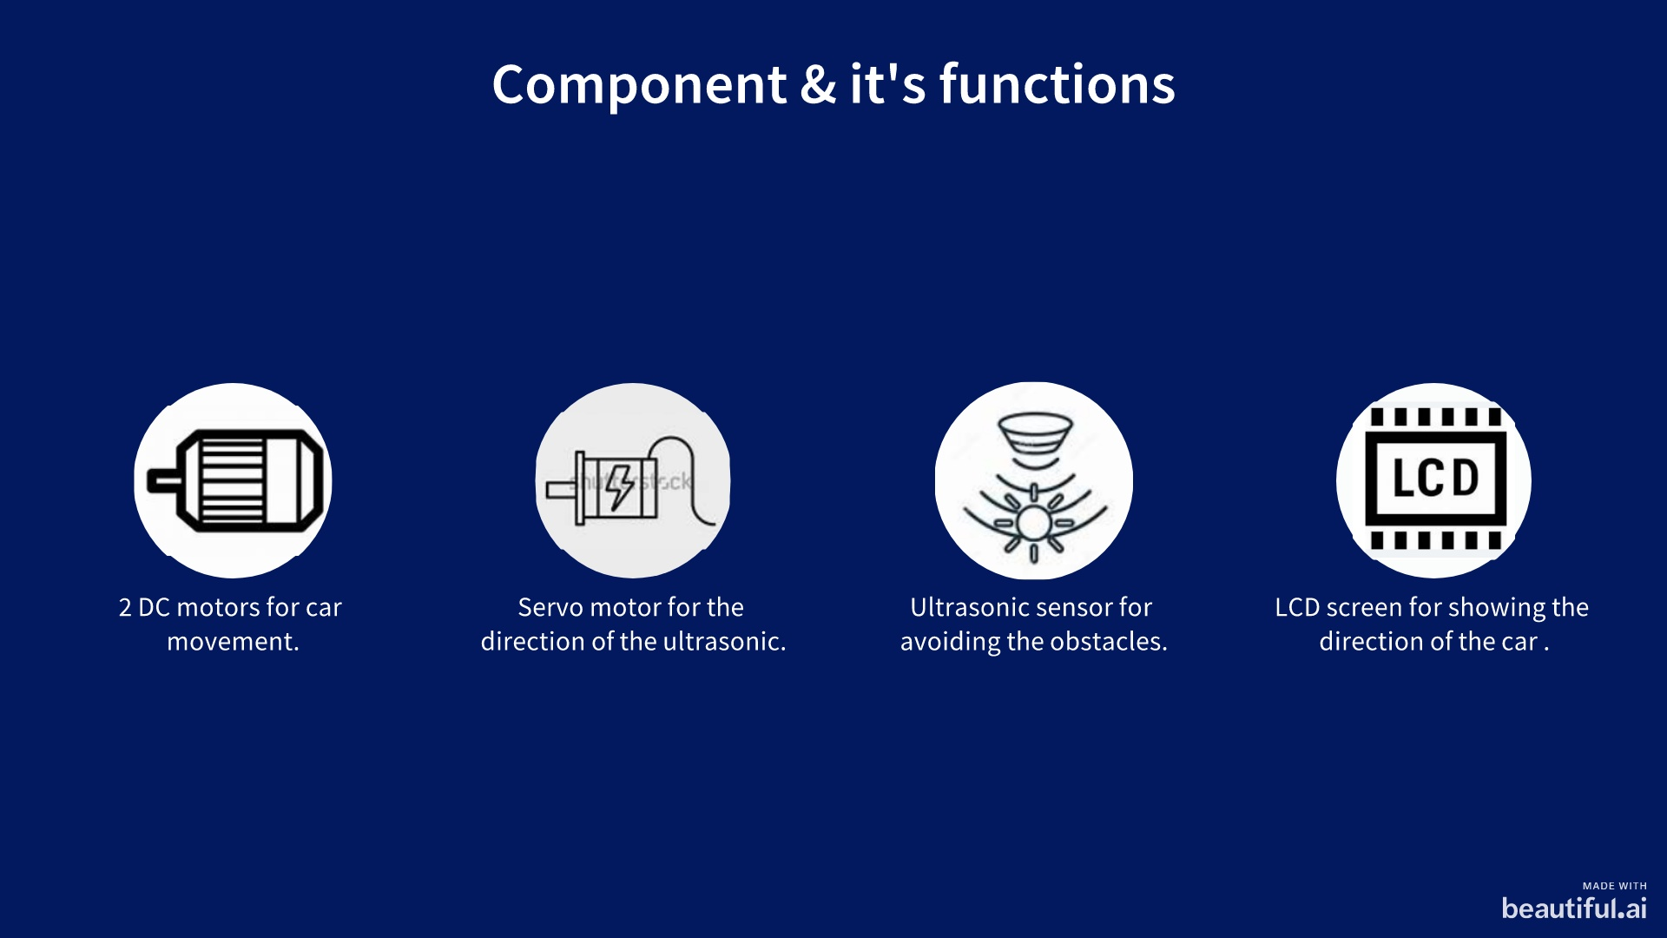
Notes:
add note

Slide 3
How does each device work?
Car
DC motor
Servo motor
Ultrasonic
LCD screen
DIO (relay)
“H-bridge corrupted”
Timer 2
Timer 1
(Input Capture)
Driver written in HAL

Slide 4

Flowchart Explanation

Slide 5
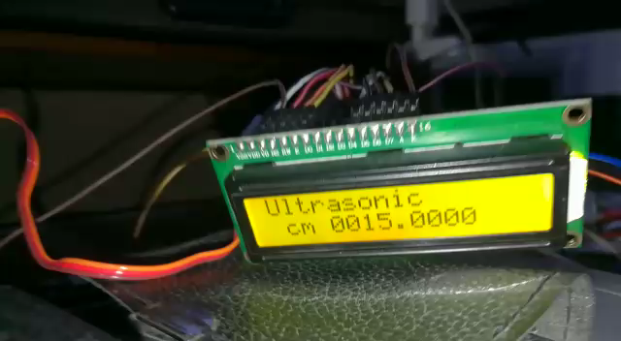
Servo –Ultrasonic –LCD (Process)

Slide 6
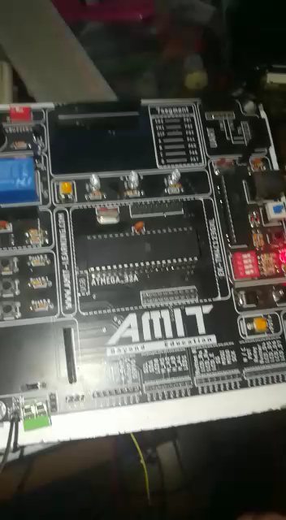
PCB not conforming to specifications as shown in the video & high noise that leads to turning on led without touching it.

Slide 7
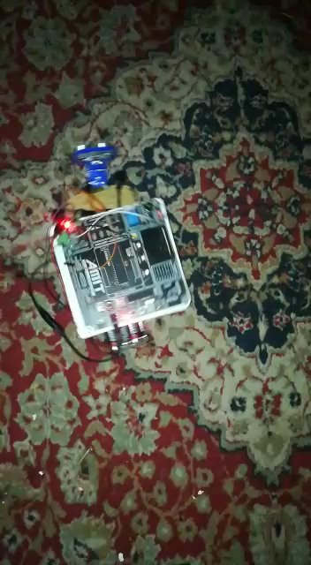
H-bridge was working as shown in the video below & one time it burned

Slide 8
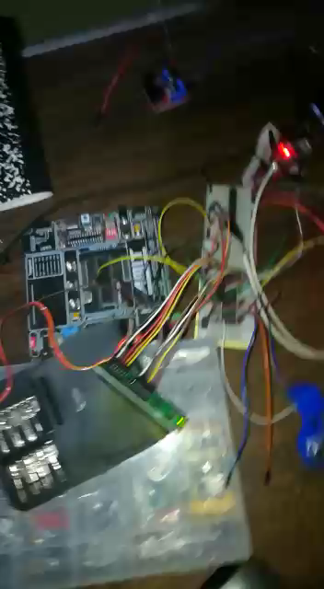
Project absorbs more power because we only have 2 dc motors, so we will use external batteries. All this information is shown in the videos after a very deep effort. In addition, many of the information was not in the diploma

Slide 9

Thank You

